Slide 1
A web-based GIS tool for exploring the world's biodiversity: The Global Biodiversity Information Facility Mapping and Analysis Portal Application (GBIF-MAPA)
Group 8: Ewelina Kwiatkowska, Katharina Kunstman,
Jan Schwalb and Malte Simon
Keywords:
Biodiversity mapping, Online Geographic Information Systems, Species richness, Survey gap analysis, Global Biodiversity Information Facility

Slide 2
1. Introduction
„Overall, we are locked into a race. We must hurry to acquire the knowledge on which a wise policy of conservation and development can be based for centuries to come“. E.O. Wilson (1988)
In the quote, Wilson (1988) urges the global biodiversity community to develop a wise set of policies for biological conservation.
-Wisdom: is the top portion of a hierarchy, includes data, information and knowledge
-In order to achieve wisdom, one must first have data — raw observations and measurements.
The raw data formuch of biodiversity research are specimen occurrence records — when and where species are found.

Slide 3
- GBIF (Global Biodiversity Information Facility)- has developed an infrastructure by which museums and herbaria can publish their databases to a global network of biodiversity data.
As of March 2007, provides GBIF access over the Internet to approximately 120 million species occurrence records from over 1000 separate collections.
- EstimateS provide estimations of species richness
- DIVA-GIS provide GIS capabilities and a suite of biodiversity analysis modules
- GBIF-MAPA- a web-based biodiversity workflow tool that provides users the means to semi-automate raw biodiversity data acquisition, geospatial visualization and deployment of core biodiversity analyses

Slide 4
2. Case studies
- The point of developing GBIF-MAPA was to provide a means for users to select any region in the world and ask core biodiversity research questions like:
- Is there enough existing biodiversity data to determine accurate measures of species richness?
- “Where is the most likely spot to survey for more biodiversity given the current species occurrences and environmental conditions?
- Case study 1: Survey Gap Analysis tool (SGA) = Best location for field survey depending on previous study sites.
- Case study 2: Species Richness Analysis tool (SRA) = Find the best sites with high species richness.
Case study criteria:
Criteria 1:The regions and taxa were not ones with which we were intimately familiar.
Criteria 2:The regions are known to be hotspots for biodiversity.
(Flemons et al. 2007)

Slide 5
Case study 1: „Where to look for new frog and toad species on Madagascar?”
- The amphibian Order Anura (frogs and toads) was chosen for this case study because there are only a few Anura records from the GBIF data cache on mainland Madagascar.
This distribution suggests that there may be undiscovered anuran species on Madagascar (Case study criteria 1: Taxa not well researched)
- We used the Survey Gap Analysis tool to determine best survey locations on Madagascar for anurans
(Flemons et al. 2007)

Slide 6
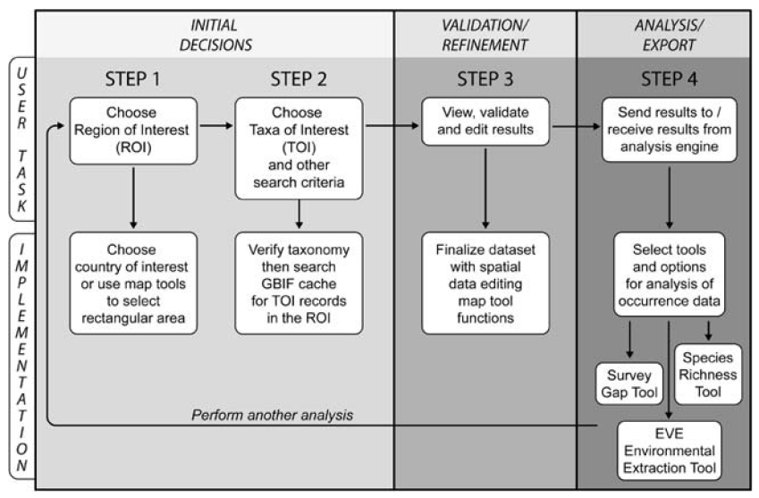
General workflow
(Flemons et al. 2007)

Slide 7
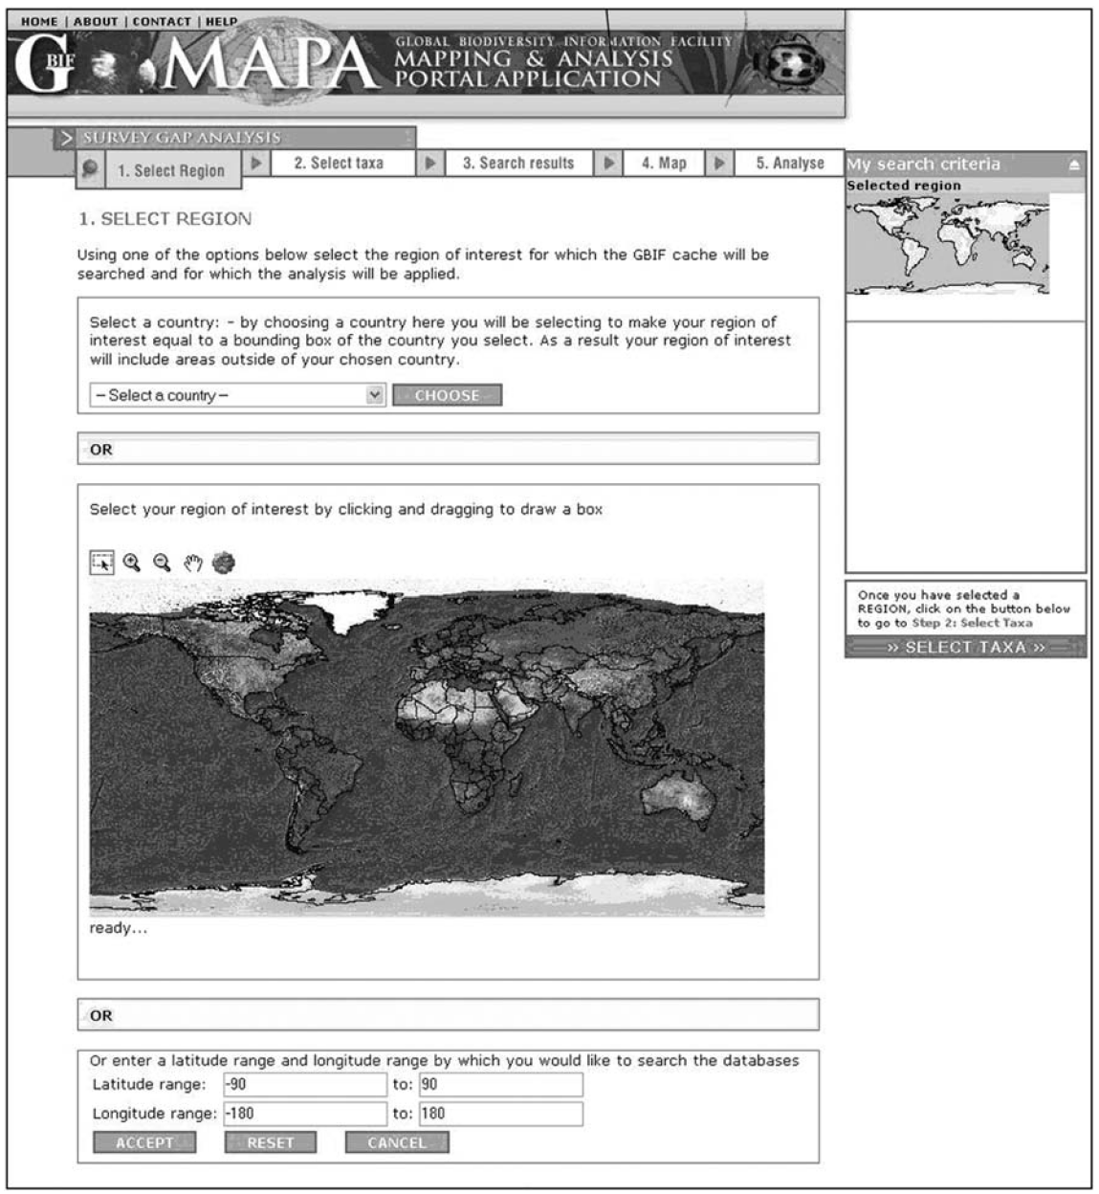
Application Interface
(Flemons et al. 2007)

Slide 8
Workflow for case study 1
I. Initial decisions:
Step 1: ROI = Madagascar
Step 2: TOI = Anura
II. Validation/Refinement:
Step 3: View and validate results
→ Delete anura taxa occurring in the sea
III. Analysis/Export
Step 4: Tool selection = Survey Gap Analysis
→ Data extraction (Best study sites to search for anura)
(Flemons et al. 2007)

Slide 9
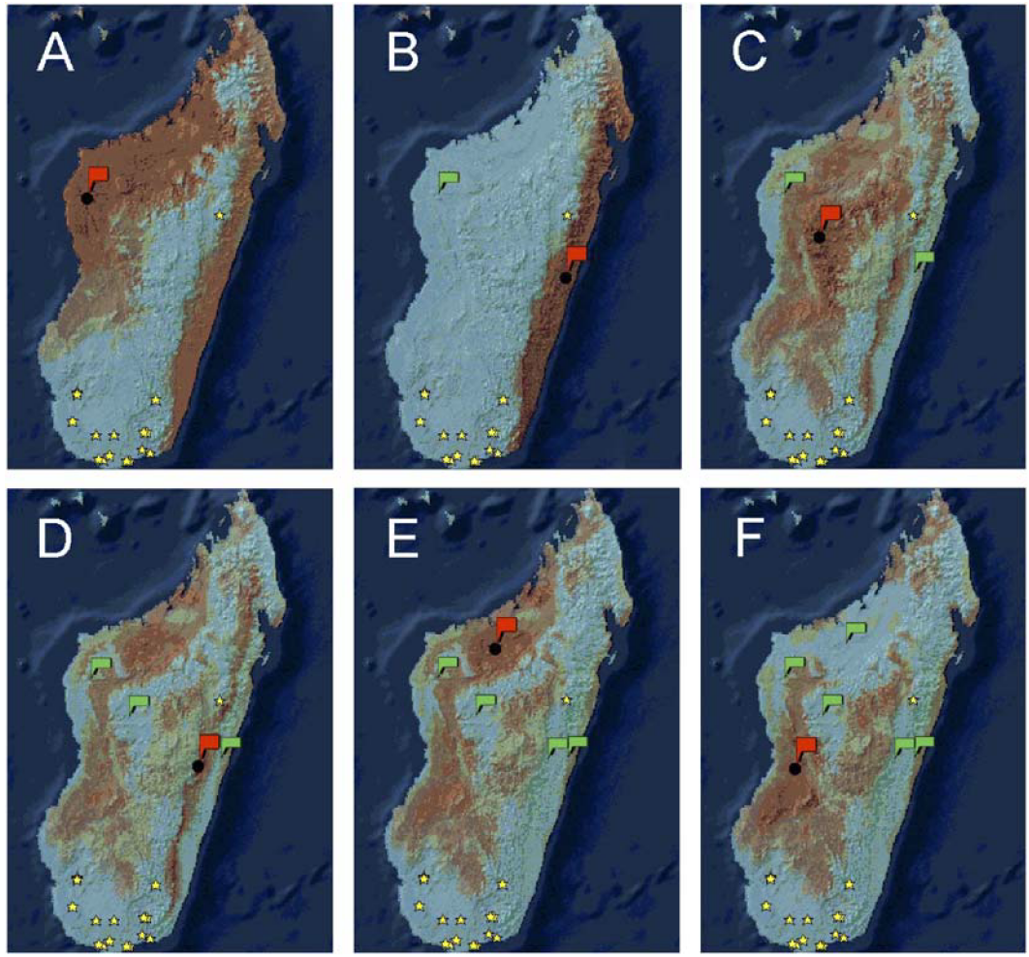
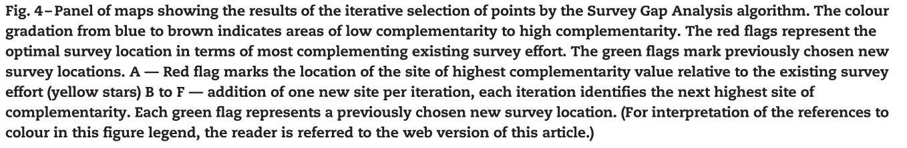
Results of Survey Gap Analysis
(Flemons et al. 2007)

Slide 10
Case study 2: “Can Ethiopian rodent species richness be estimated using GBIF data?”
-The case study for species richness assessment is rodent richness in the country Ethiopia.
-The country comprises the Ethiopian Highlands, which is one
of thirty four global biodiversity hotspots. (Case study criteria 2: High biodiversity)
-It is also an area of global conservation concern given high species richness and number of endemics, and given increasing and dramatic human impact on the area.
(Flemons et al. 2007)

Slide 11
Workflow for case study 2
Initial decisions:
Step 1: ROI = Ethiopia
Step 2: TOI = Rodentia
II. Validation/Refinement:
Step 3: View and validate results (delete unfitting entries)
→1053 specimen occurrence records
→ delete uncompleted entries
III. Analysis/Export
Step 4: Tool selection = Species Richness Analysis
→ Data extraction
(Flemons et al. 2007)

Slide 12
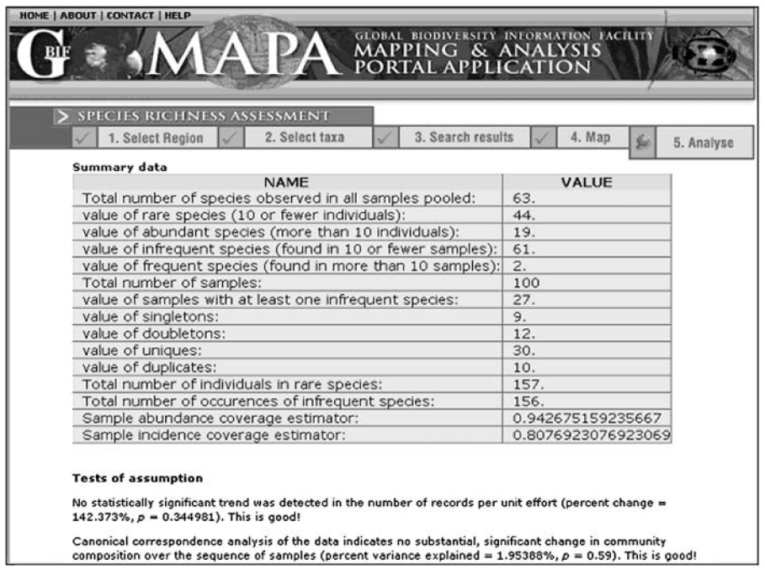
Species Richness Analysis
(Flemons et al. 2007)

Slide 13
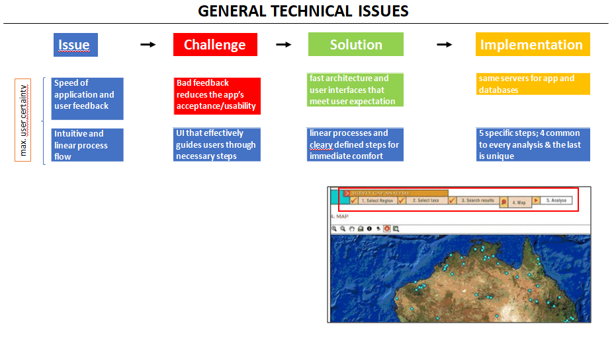
(Flemons et al. 2007)

Slide 14
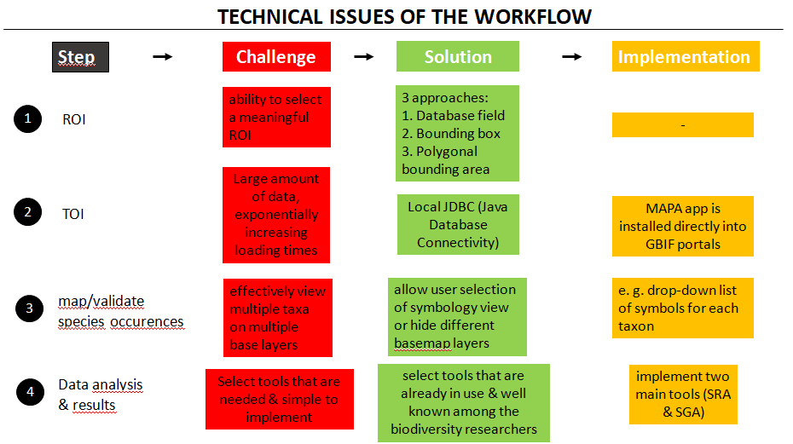
(Flemons et al. 2007)

Slide 15
a. What were the main questions (or objectives) addressed?
Supporting research, conversation management, and education with high quality global diversity data
How to build tools which use the GBIF data portal, giving access to researchers to allow to use the whole spectrum of available data
(Flemons et al. 2007)

Slide 16
b. How did the authors tackle them? (what did they do?)
Building a tool to perform biodiversity analysis with a end-to-end workflow
Three types of analyses:
environmental extraction
survey gap analysis
species richness assessment
Focusing on:
user-friendly interface
speed
flexibility in designing output
(Flemons et al. 2007)

Slide 17
c. What aspects could be added/done differently/problems?
Paper was published in 2007, outdated
MAPA webpage is not available, only reference screenshots in the paper
No possibility to try it out, hard to visualize technical issues and service
No information how gbif.org looked like back then
In second case study, incomprehensible what quality the output has

Slide 18
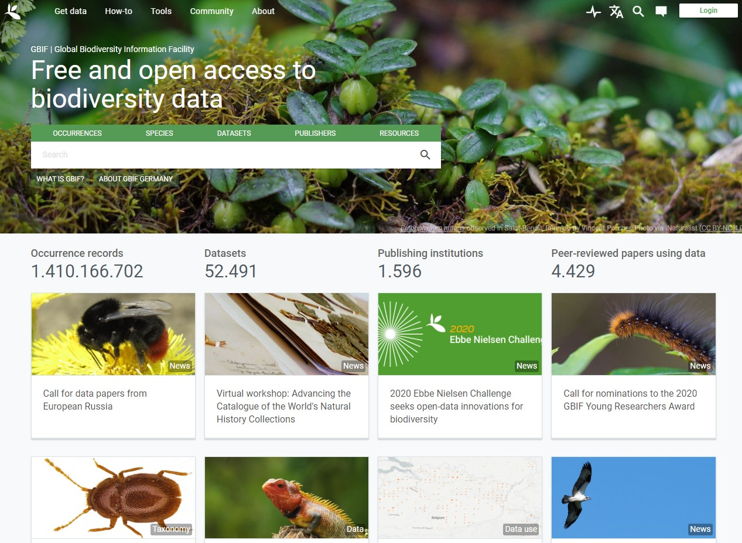
Able to search after species, occurrences, data sets
Tables, pictures of occurrences
(Gbif.org 2020)

Slide 19
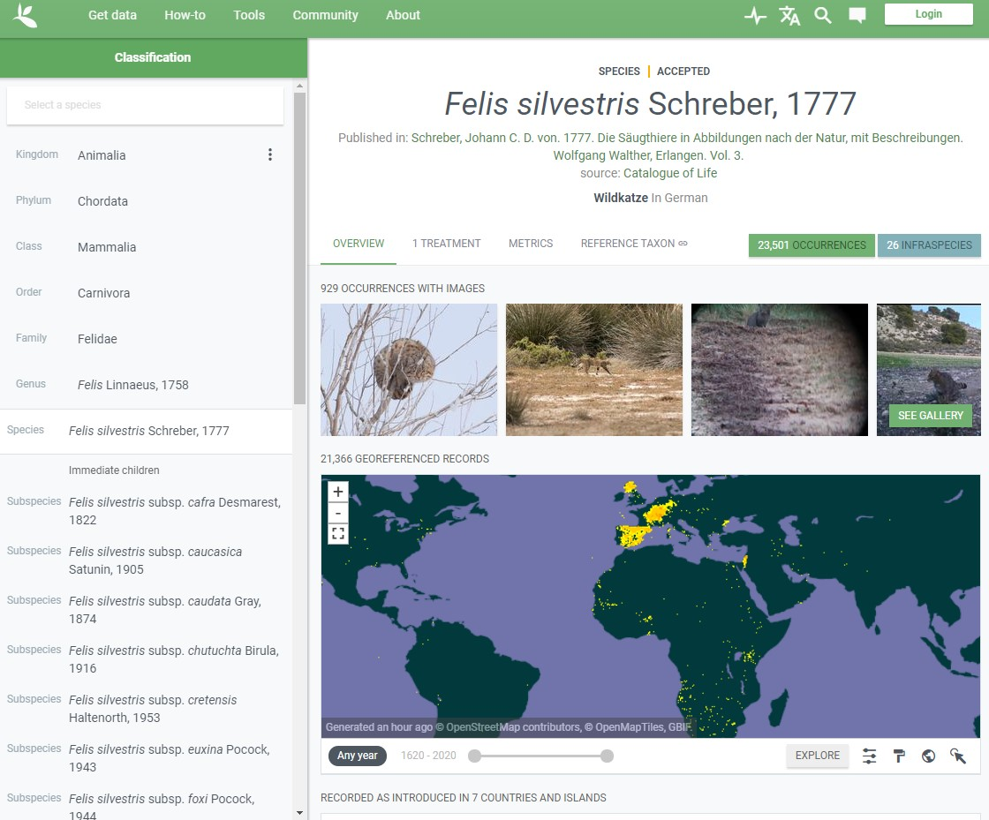
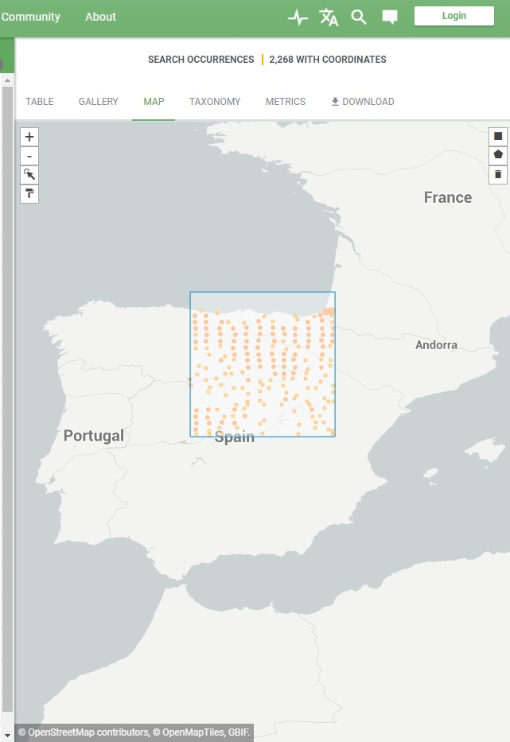
Gbif has an interactive map
Able to look into particular regions
(Gbif.org 2020)

Slide 20
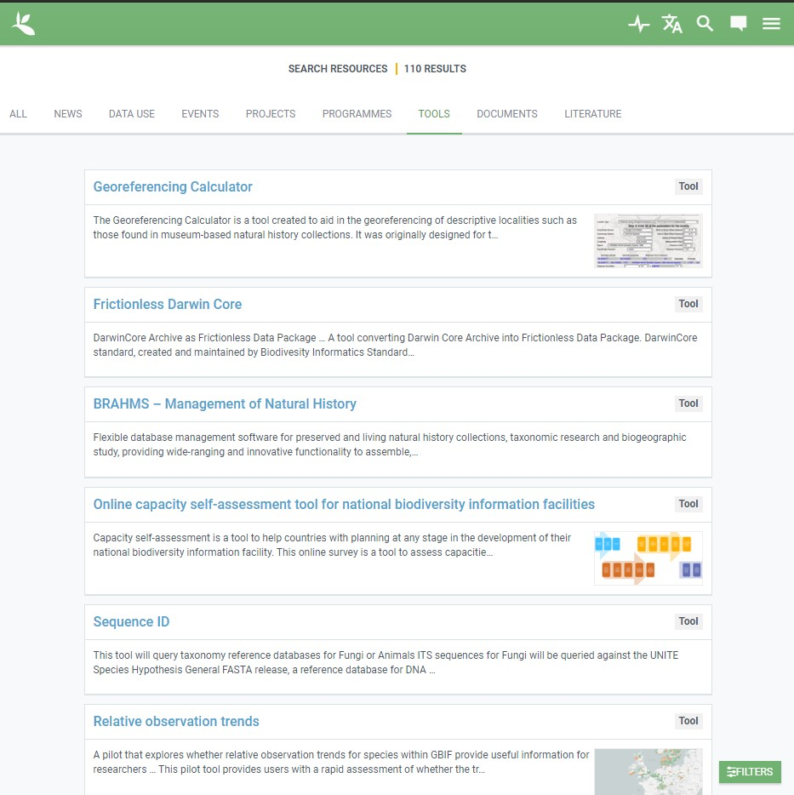
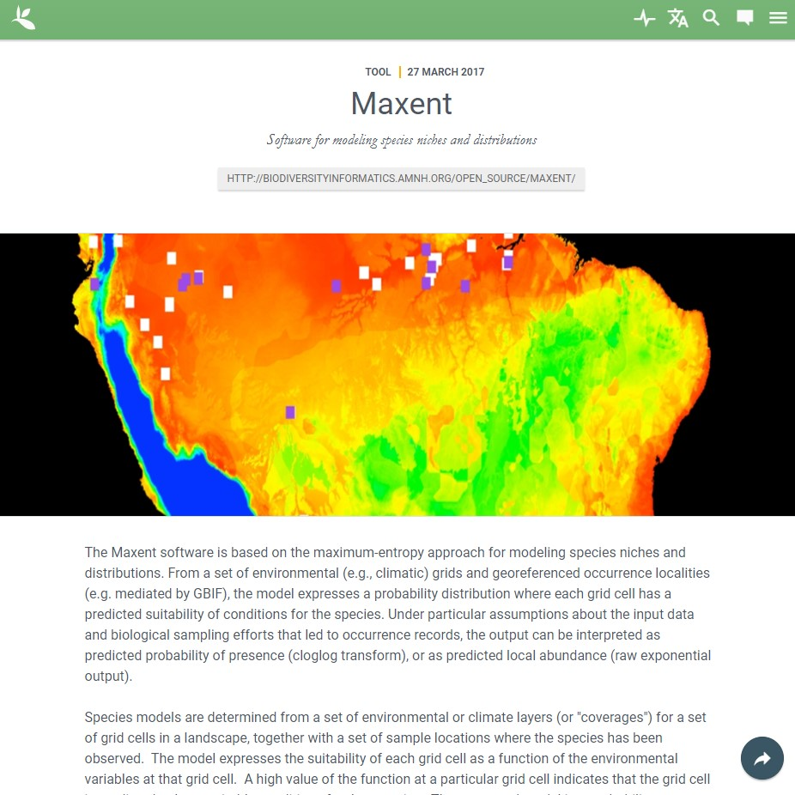
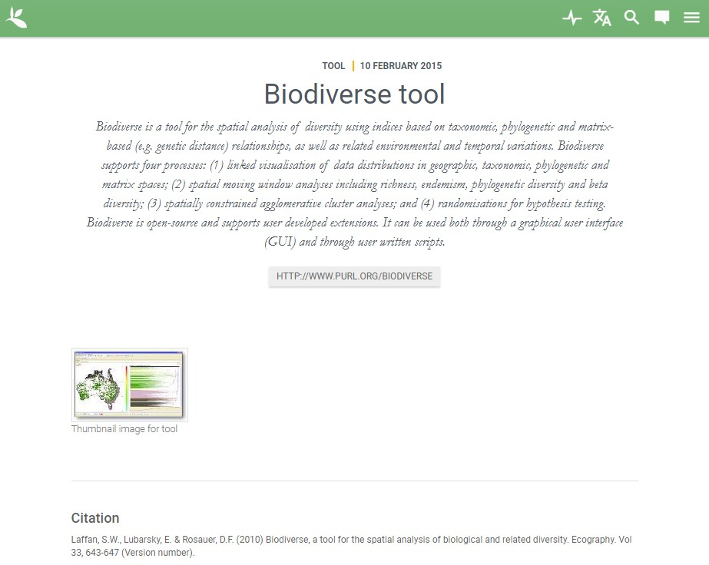
A lot of tools for cleaning and validating data
Now more tools for SDM and predicting survey locations: MaxEnt, Biodiverse, Rpackages, OpenModeller, etc.
(Gbif.org 2020)

Slide 21
References
Flemons, P., Guralnick, R., Krieger, J., Ranipeta, A. & Neufeld, D. (2007): A web‐based GIS tool for exploring the world's biodiversity: the global biodiversity information facility mapping and analysis portal application (GBIF‐MAPA). Ecological Informatics, 2, 49– 60.

